Slide 1
Interacting with the user
Ryan Volum
Christopher Harrison

Slide 2
Agenda - list all main modules
1
Prompts
6
Cards
2
User actions
7
Title for Section 7. Size 20 pt
3
Title for Section 3. Size 20 pt
8
Title for Section 8. Size 20 pt
4
Title for Section 4. Size 20 pt
9
Title for Section 9. Size 20 pt
5
Title for Section 5. Size 20 pt
10
Title for Section 10. Size 20 pt

Slide 3
Prompts
Speaker name(s)

Slide 4
Prompts are how you ask the user questions
Free form
Number
List of options

Slide 5
Best practices
Minimize typing
Mobile keyboards aren't fun to type on
Direct the user
Easy to get lost
Provide help
List the commands

Slide 6
Prompt types
Free form
text
Data-type detection
number
time
List of options
confirm
choice
Media
Attachment

Slide 7
Implement search
Detect the user is looking to search
Maybe add a command called search? ☺
Prompt the user for the query string
Text prompt
Prompt the user to select the user they want to see
Choice
Display the results

Slide 8
Implementing search

Slide 9
Cards
Speaker name(s)

Slide 10
Graphics are pretty...

Slide 11
We want to move beyond basic text
Display images
Formatted text
Add clickability

Slide 12
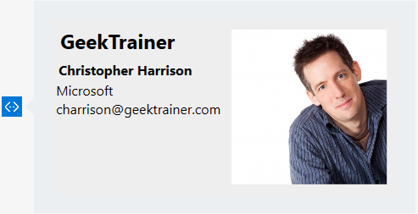
Introducing cards
Provide a title
A subtitle
Some additional text
An event handler for tap
And a pretty(?) picture

Slide 13
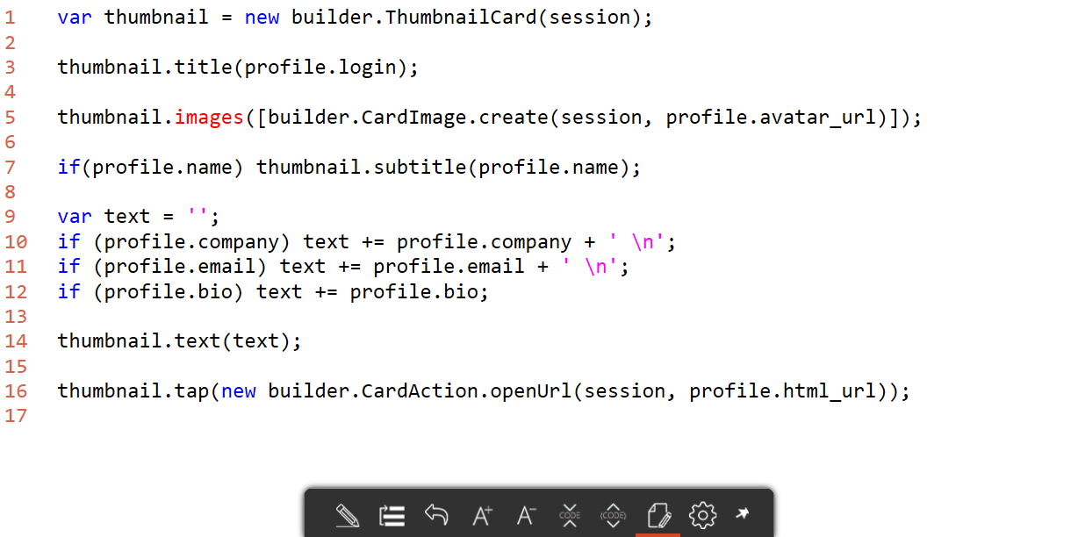
Creating cards

Slide 14
Creating cards

